Slide 1
Cognitive Graph: Representation, Reasoning, and Generation
Jie Tang
Computer Science
Tsinghua University
  The slides can be downloaded at http://keg.cs.tsinghua.edu.cn/jietang

Slide 2
Knowledge Graph
“Knowledge graph” was used by Google 2012
Knowledge engineering, expert system
CYC: the world's longest-lived AI project (1985)

Slide 3
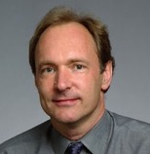
Knowledge & AI
* Two keys for AI: Knowledge Base + Intelligent Algorithm
Edward Feigenbaum
Father of KB
Turing Award
Tim Berners Lee
Father of WWW
Turing Award
Big Data
Knowledge
Intelligence
[1] J. Tang, J. Zhang, L. Yao, J. Li, L. Zhang, and Z. Su. ArnetMiner: Extraction and Mining of Academic Social Networks. KDD’08. pp.990-998.
Notes:
How to populate a semantic-based profile database for researchers?

Slide 4
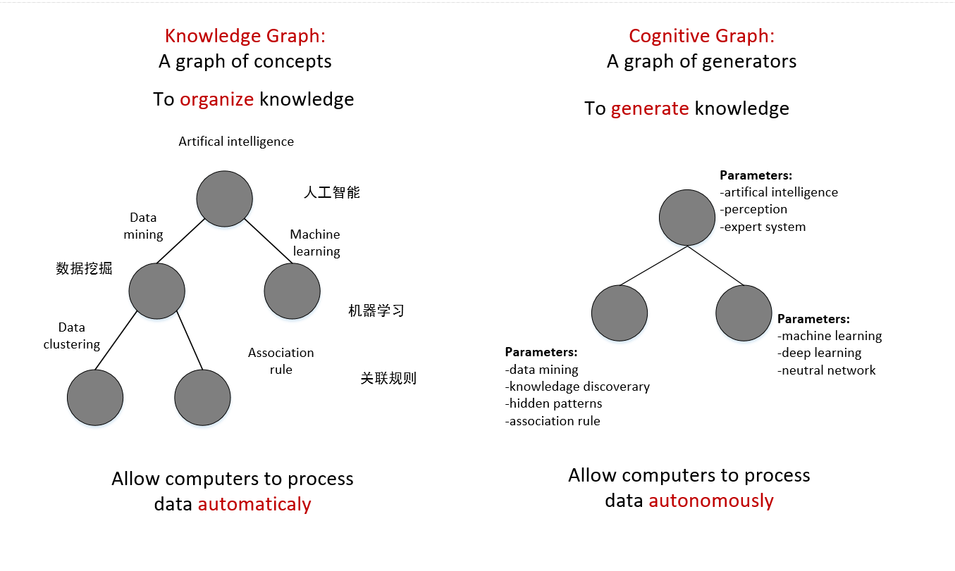
ReThinking… (Recall CNCC’18)
数据
知识图谱
认知图谱
数据处理的自动化
数据处理的自治性

Slide 5
Let us start with an example
—Recommendation

Slide 6
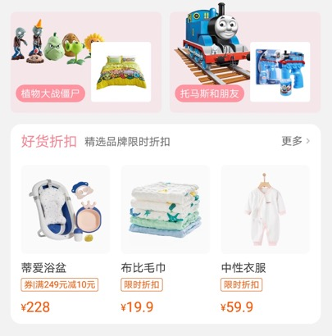
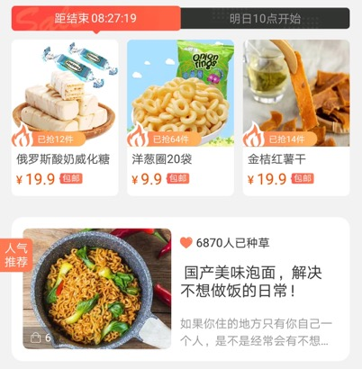
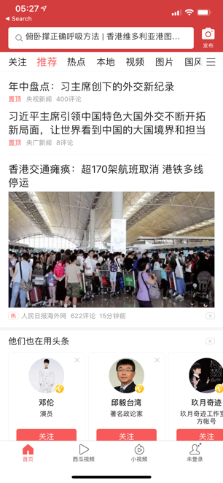
Feed Recommendation
Challenges
Representation
Adaptive
Recommendation
eXplainable Recommendation

Slide 7
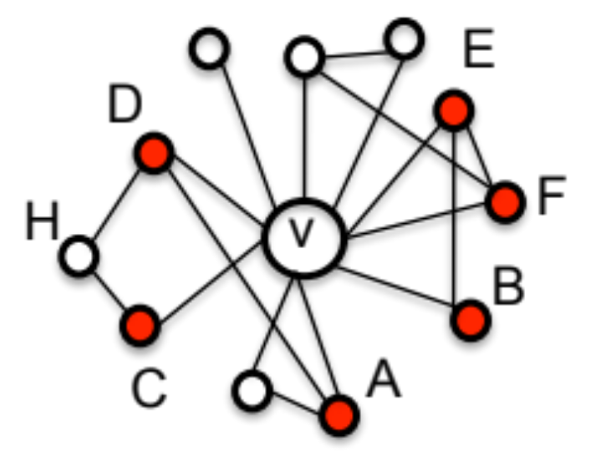
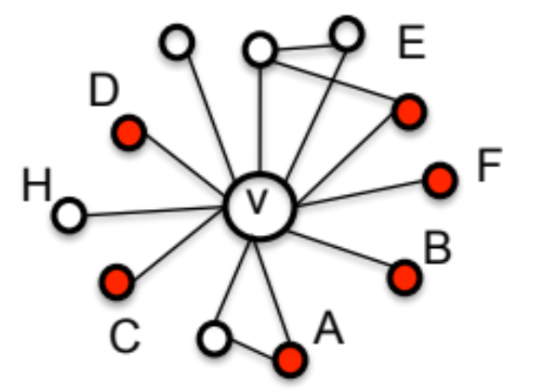
Recommendation
  Example: TaoBao
v₁
v₂
Who are more likely to be “active”, v₁ or v₂?
e.g., active = “Buy/Click an item”
Inactive neighbor
Active neighbor
v
User to be influenced
J. Qiu, J. Tang, H. Ma, Y. Dong, K. Wang, and J. Tang. DeepInf: Social Influence Prediction with Deep Learning. KDD'18.

Slide 8
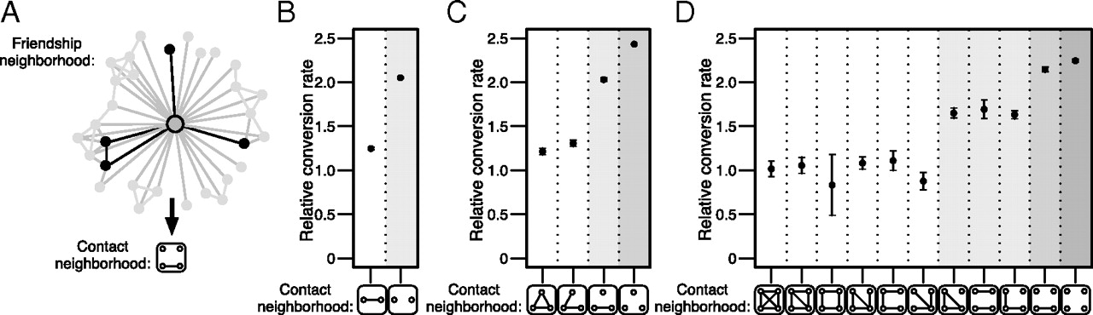
Structural Influence
J. Ugander, L. Backstrom, C. Marlow, J. Kleinberg. Structural diversity in social contagion. PNAS, 2012, 109 (16) 5962-5966.

Slide 9
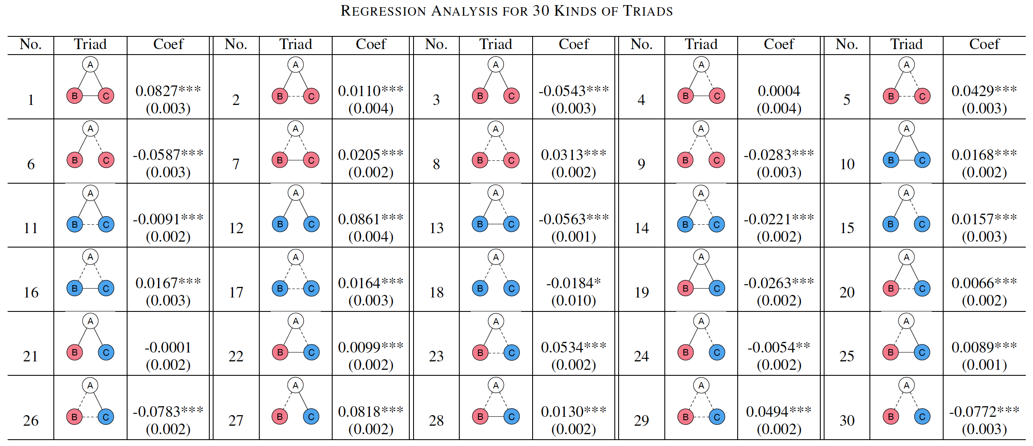
Influence Learning
Learning influence in signed triads
And apply the triadic influence for prediction

Slide 10
Possible Solution
Influence features + Hand craft features
predictive model
Class +1
+
Class -1
predictive model
But defining features is tedious and inefficient…

Slide 11

Representation Learning on Networks
?
Class +1
0.8
0.2
0.3
…
0.0
0.0
Class -1
How to automate the representation of each user?

Slide 12
Outline
Representation Learning for Complex Networks
Reasoning for Complex Scenarios
Generation for Explaining Prediction
Conclusion and Q&A

Slide 13
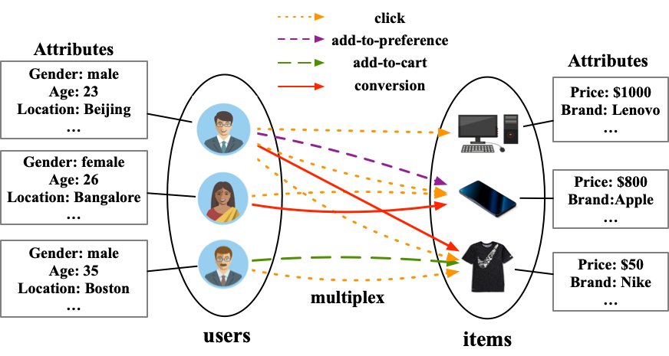
Representation Learning for Multiplex Networks
Multiplex networks comprise not only multi-typed nodes and/or edges but also a rich set of attributes.
How do we deal with the multiplex edges?
Notes:
Given the attributed multiplex network, how do we predict whether a user will click or buy an item? We formalize this problem as a multiplex link prediction problem. How do we solve this problem? Representation learning is a appropriate method to solve this problem.

Slide 14




Review Representation Learning for Networks
d-dimensional vector, d<<|V|
Representation Learning/
Graph Embedding
0.8
0.2
0.3
…
0.0
0.0
Users with the same label are located in the d-dimensional space closer than those with different labels
e.g., node classification
label2
label1

Slide 15
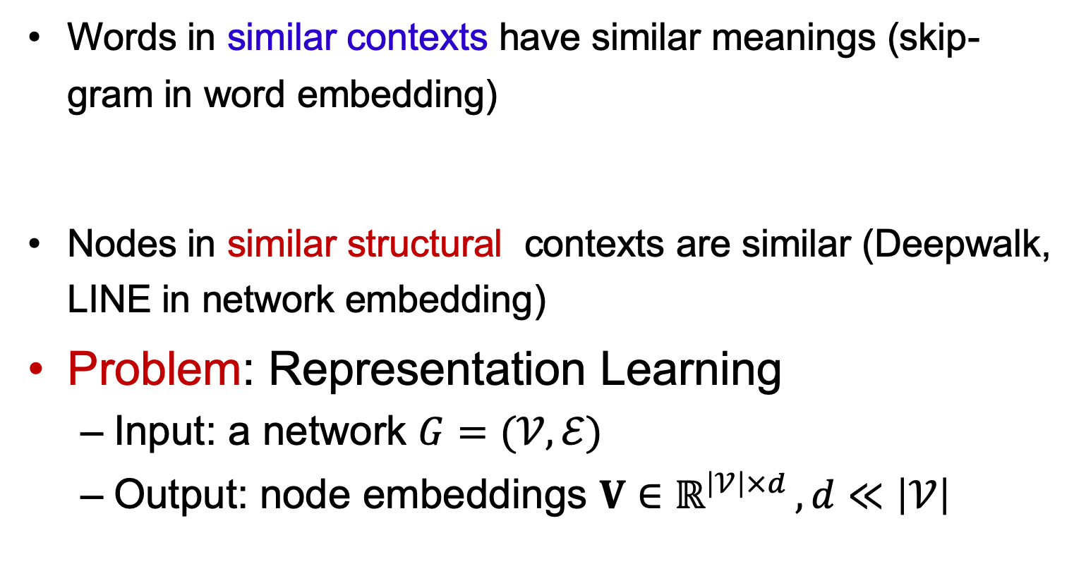
Distributional Hypothesis of Harris
Words in similar contexts have similar meanings (skip-gram in word embedding)
Nodes in similar structural contexts are similar (Deepwalk, LINE in network embedding)
Problem: Representation Learning
  Input: a network $G=(𝒱,ℰ)$
  Output: node embeddings $V∈ℝ^{\left|𝒱\right|×d }, d≪\left|𝒱\right|$
Notes:
As we all know, in skip-gram model, words in similar contexts have similar meanings.
Therefore, migrating the distribution hypothesis in NLP, we have that nodes with similar structural contexts are similar in graphs, and their embedding should be closer.

Slide 16
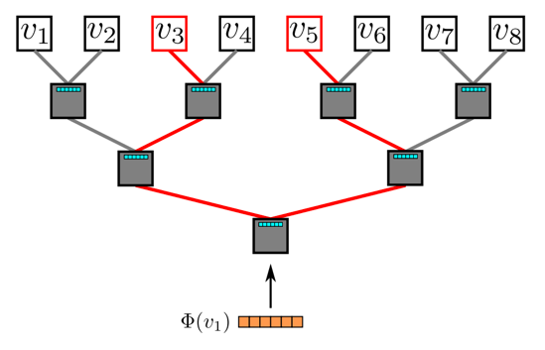
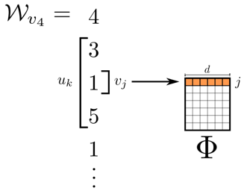
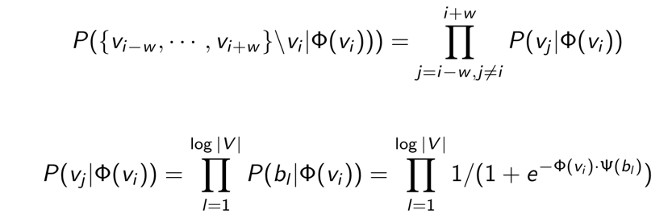
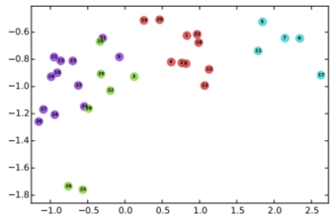
DeepWalk
Random walk
One example RW path
SkipGram with Hierarchical softmax
v₃
v₄
v₄
v₃
v₁
v₅
v₆
v₁
v₅
v₂
v₆
Hierarchical softmax
B. Perozzi, R. Al-Rfou, and S. Skiena. 2014. Deepwalk: Online learning of social representations. KDD, 701–710.

Slide 17
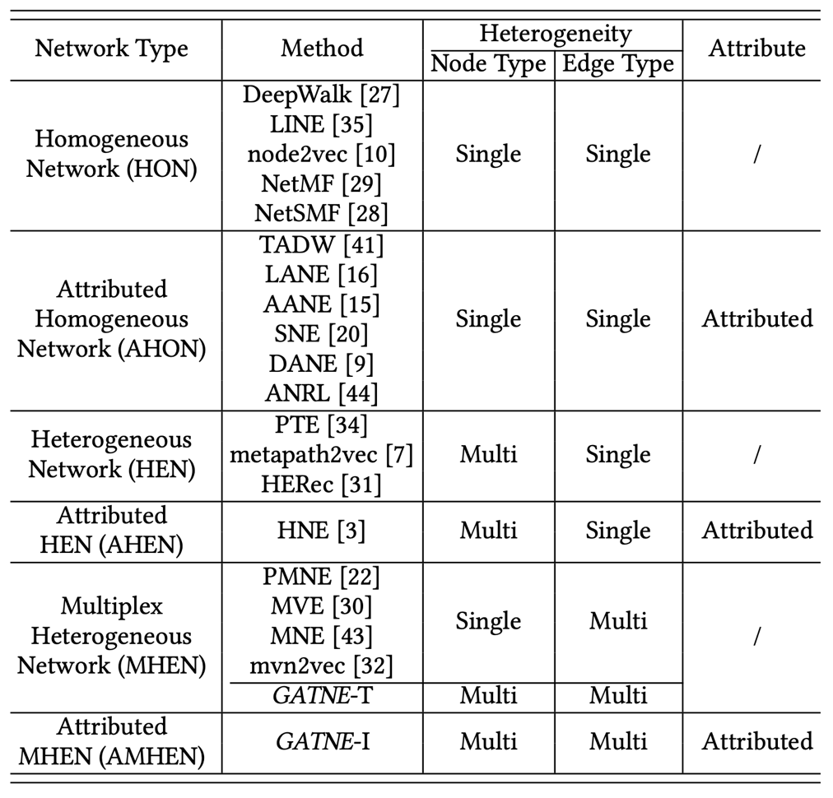
Six Different Network Types
Notes:
There have been tremendous attempts in the literature to investigate embedding learning for complex networks. Depending on the network topology and attributed property, we categorize six different types of networks：HON, AHON, HEN, AHEN, MHEN, AMHEN. As we can seen, among them the AMHEN has been least studied.

Slide 18
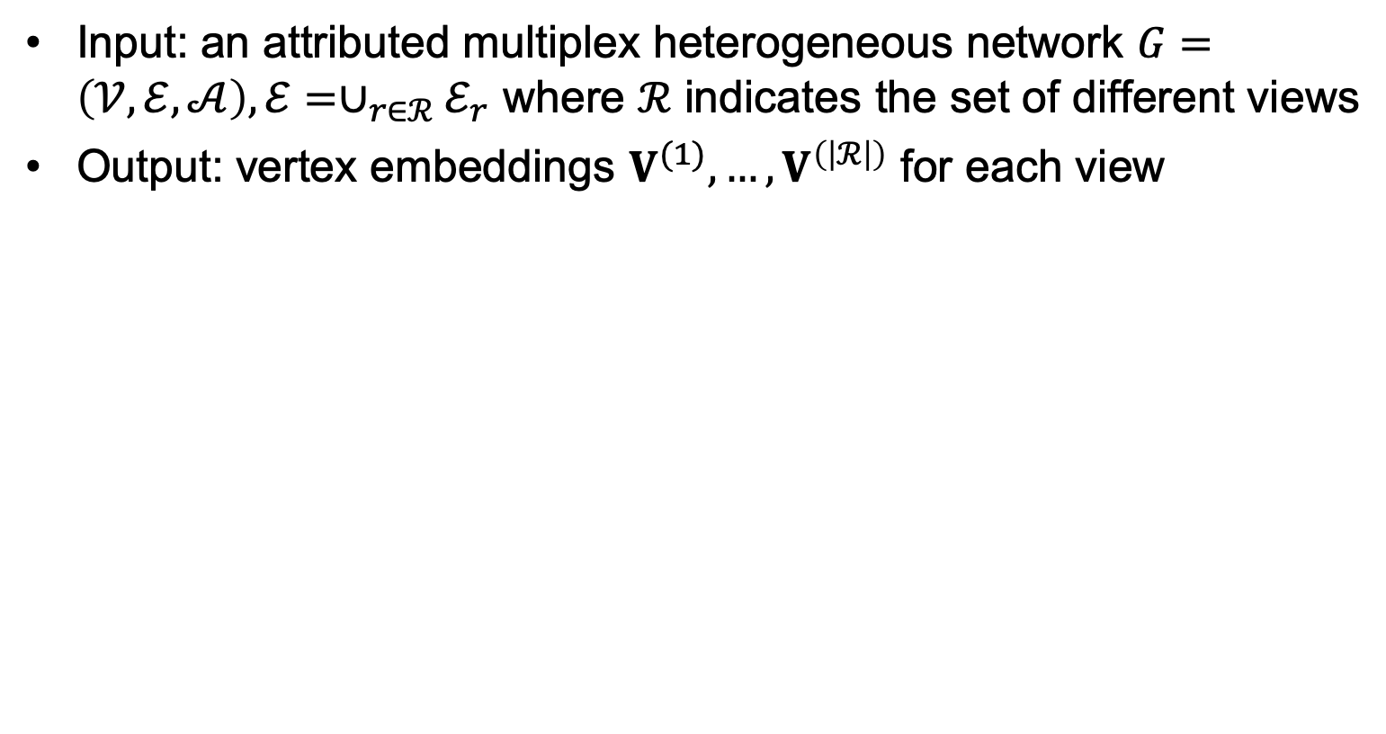
Problem: AMHEN Embedding
Input: an attributed multiplex heterogeneous network $G=\left(𝒱,ℰ,𝒜\right), ℰ=∪_{r∈ℛ}ℰ_{r}$ where $ℛ$ indicates the set of different views
Output: vertex embeddings $V^{(1)},…,V^{\left(\left|ℛ\right|\right)}$ for each view
$ℛ$={click, add-to-preference, add-to-cart, conversion}
Notes:
Now, we formalize our problem. Given an attributed multiplex heterogeneous network, the problem is to learn node embeddings for each view. For example, in this e-commerce situation, we need to learn four different embeddings for each node. Node embeddings of click view can do the click prediction.

Slide 19
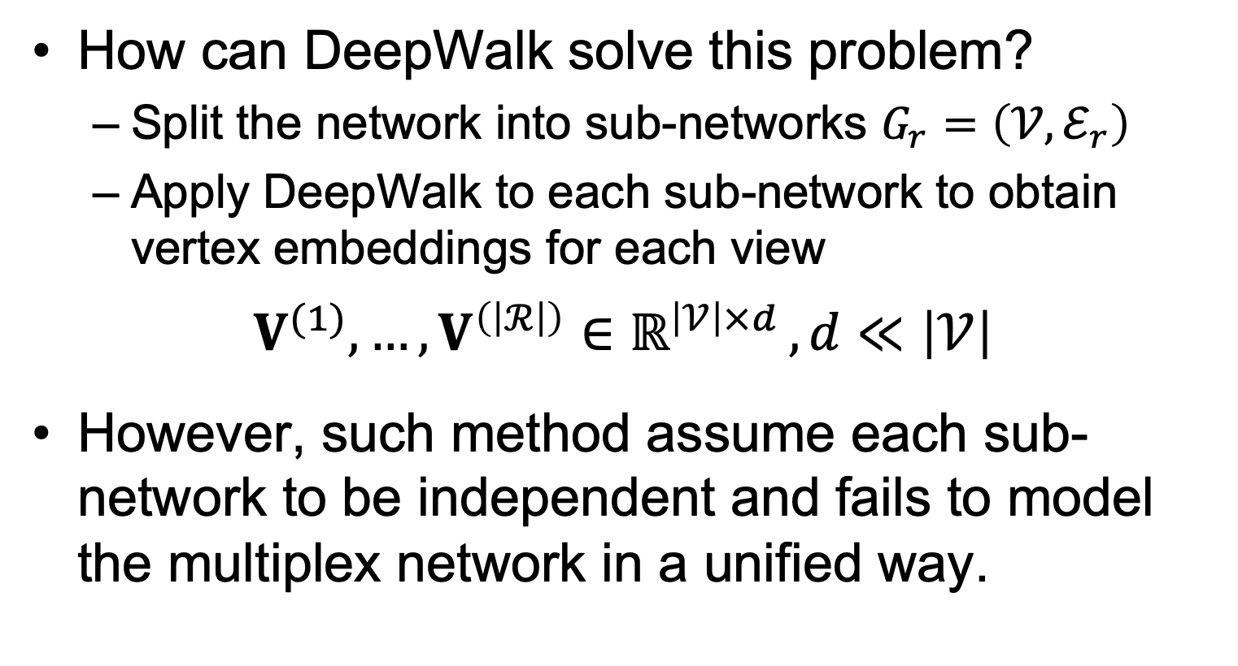
Apply DeepWalk to Multiplex Networks
How can DeepWalk solve this problem?
  Split the network into sub-networks $G_{r}=\left(𝒱,ℰ_{r}\right)$
  Apply DeepWalk to each sub-network to obtain vertex embeddings for each view
$$V^{(1)},…,V^{\left(\left|ℛ\right|\right)}∈ℝ^{\left|𝒱\right|×d }, d≪\left|𝒱\right|$$
However, such method assume each sub-network to be independent and fails to model the multiplex network in a unified way.
Notes:
How does DeepWalk solve this problem? First, we can split the network into sub-networks. Each sub-network contains the edges with the same edge type. For each sub-network, we can apply DeepWalk to obtain node embeddings. However, such method assume each sub-network to be independent and fails to model the multiplex network in a unified way.

Slide 20
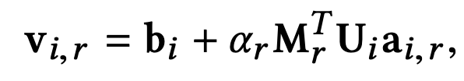
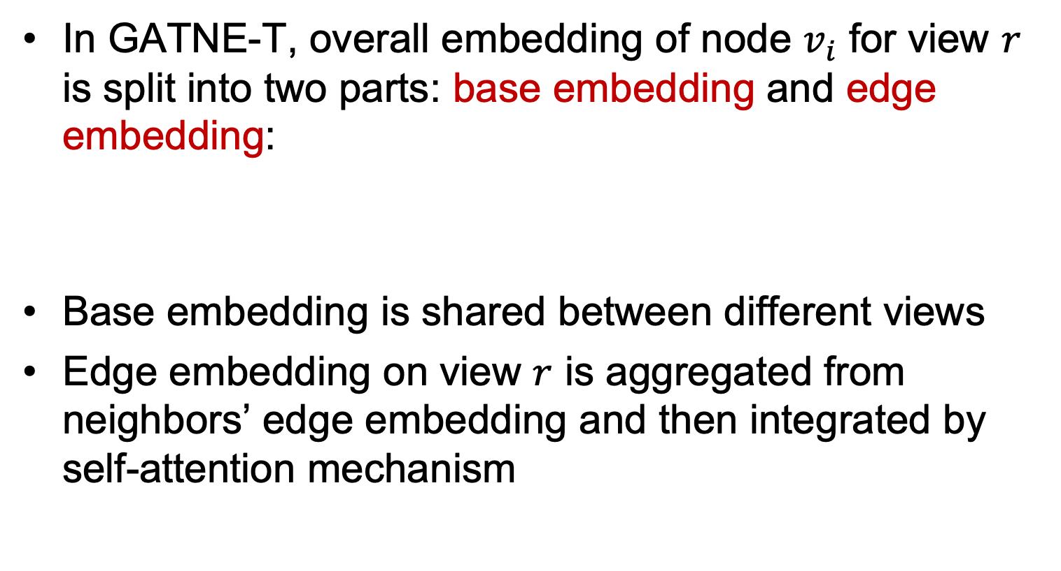
Our Transductive Model: GATNE-T
In GATNE-T, overall embedding of node $v_{i}$ for view $r$ is split into two parts: base embedding and edge embedding:
Base embedding is shared between different views
Edge embedding on view $r$ is aggregated from neighbors’ edge embedding and then integrated by self-attention mechanism
Y. Cen, X. Zou, J. Zhang, H. Yang, J. Zhou and J. Tang. Representation Learning for Attributed Multiplex Heterogeneous Network. KDD’19.
Notes:
In GATNE-T, overall embedding of node $v_{i}$ for view $r$ is split into two parts: base embedding and edge embedding. Base embedding is shared between different views. Edge embedding on view $r$ is aggregated from neighbors’ edge embedding and then integrated by self-attention mechanism.

Slide 21



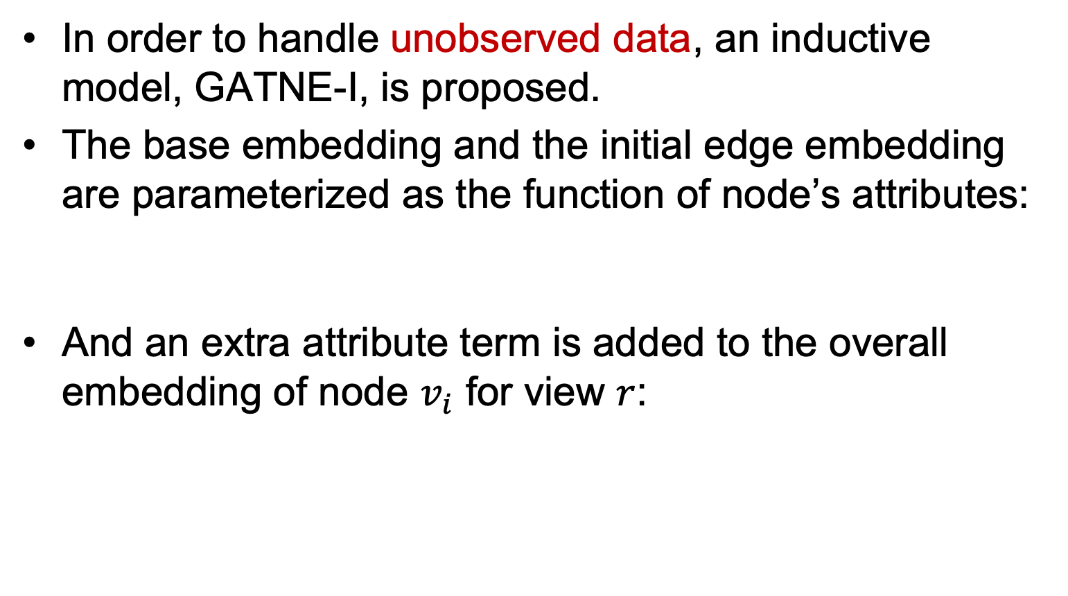
Inductive Model: GATNE-I
In order to handle unobserved data, an inductive model, GATNE-I, is proposed.
The base embedding and the initial edge embedding are parameterized as the function of node’s attributes:
And an extra attribute term is added to the overall embedding of node $v_{i}$ for view $r$:
transformation function from attributes to base embeddings
transformation function from attributes to edge embeddings
Notes:
In order to handle unobserved data, an inductive model, GATNE-I, is proposed. The base embedding and the initial edge embedding are parameterized as the function of node’s attributes. And an extra attribute term is added to the overall embedding of node $v_{i}$ for view $r$, where z represents the node type.

Slide 22
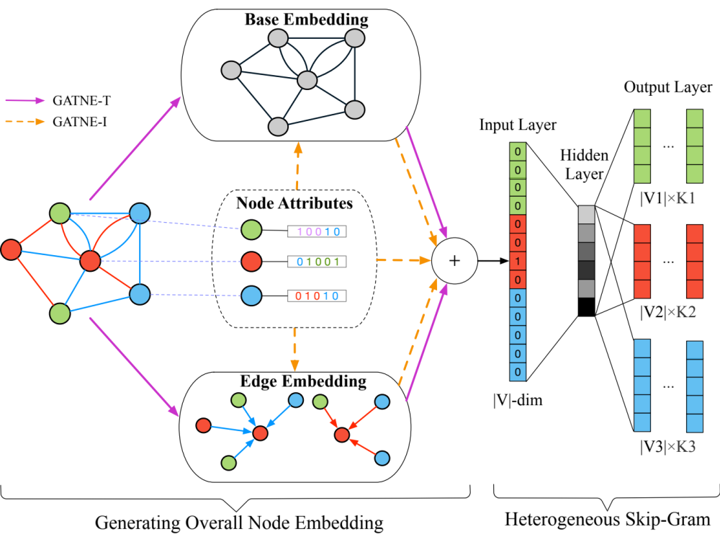
GATNE: Multiplex Heterogeneous Graph Embedding
Y. Cen, X. Zou, J. Zhang, H. Yang, J. Zhou and J. Tang. Representation Learning for Attributed Multiplex Heterogeneous Network. KDD’19.
Notes:
This is the overview of our models. The left part of the figure is to generate overall node embeddings. The base embedding is the common part of the node embeddings for different views. The edge embedding, or view-specific embedding of each node for each view is aggregated from neighbors and other views. The right part of the figure is heterogeneous skip-gram.

Slide 23
Experimental Setting
Task: Link prediction
A validation/test set that contains 5%/10% randomly selected edges respectively and equal number of randomly selected non-edges.
We use the validation set for early stopping and the test set only to report the performance.
Some commonly used evaluation criteria, i.e., ROC-AUC, PR-AUC, and F1 score, are reported in our experiment.
Notes:
Let me clarify our setting of link prediction task. We use a validation/test set that contains 5%/10% randomly selected edges respectively and equal number of randomly selected non-edges. We use the validation set for early stopping and the test set only to report the performance. Some commonly used evaluation criteria, i.e., ROC-AUC, PR-AUC, and F1 score, are reported in our experiment.

Slide 24
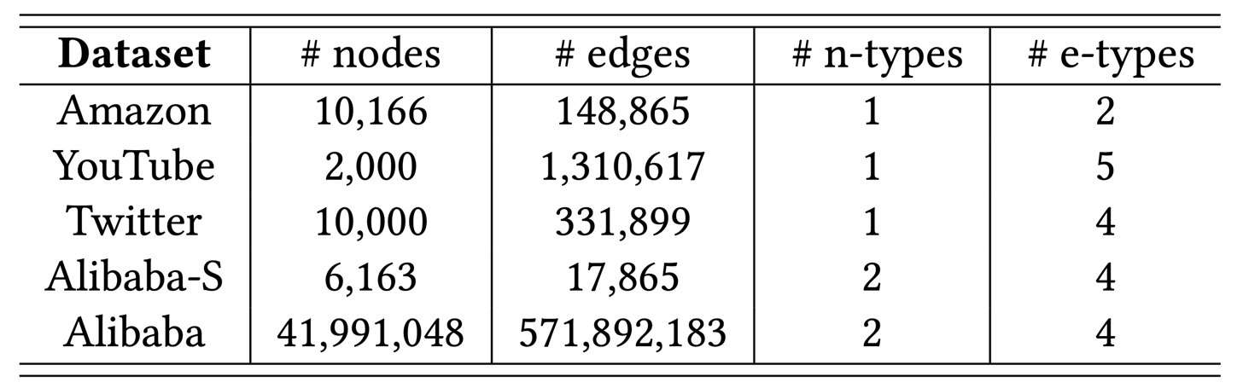
Dataset Statistics
The experiments of first four sampled datasets are conducted on a single Linux server.
The experiment on Alibaba dataset is conducted on Alibaba’s distributed cloud platform.
** Code available at https://github.com/THUDM/GATNE
Notes:
Our experiments include two parts. One is conducted on a single Linux server and the other is on Alibaba’s distributed cloud platform. In the first part of the experiments, we use four sampled datasets, including Amazon, YouTube, Twitter, and Alibaba-S. The statistics of the datasets are listed in the table.

Slide 25
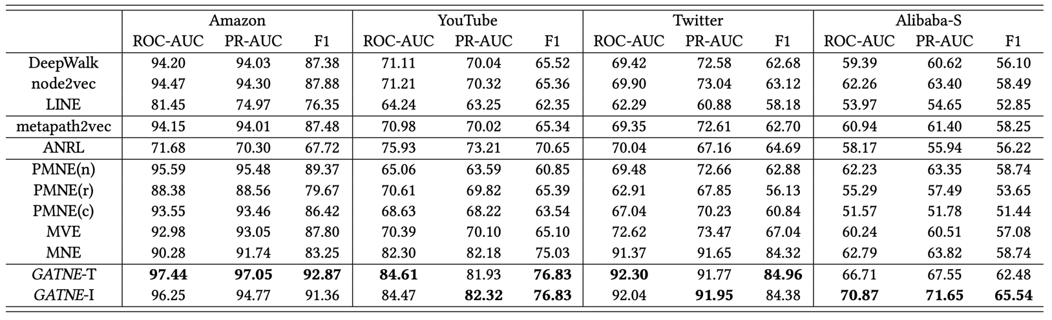
Link Prediction Results
Data
  Small: Amazon, YouTube, Twitter w/ 10K nodes
  Large: Alibaba w/ 40M nodes and 0.5B edges
GATNE outperforms all sorts of baselines in the various datasets.
** Code available at https://github.com/THUDM/GATNE

Slide 26
Outline
Representation Learning for Complex Networks
Reasoning for Complex Scenarios
Generation for Explaining Prediction
Conclusion and Q&A

Slide 27
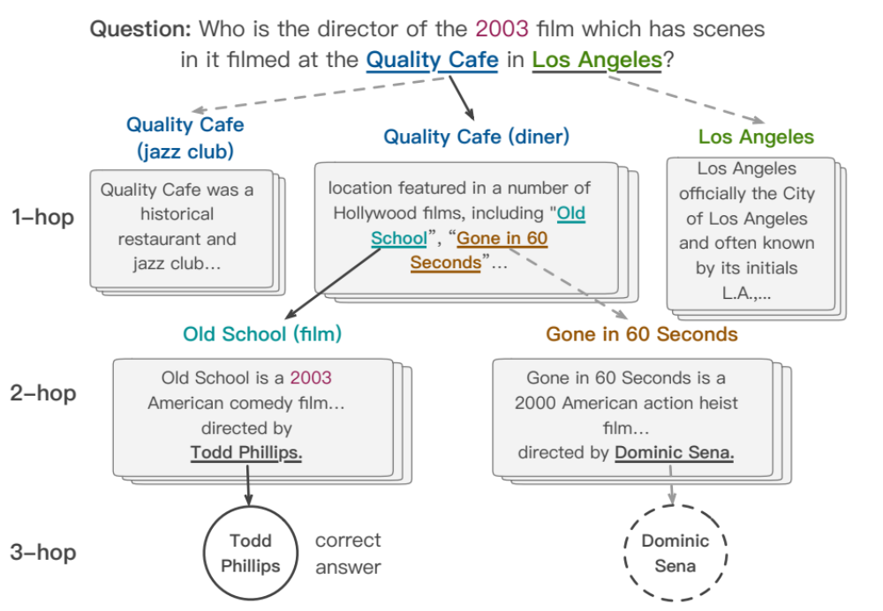

Reasoning Example: Multi-hop QA
Quality Café
Los Angeles
Alessandro Moschitti
The Quality Cafe is a now-defunct diner in Los Angeles, California. The restaurant has appeared as a location featured in a number of Hollywood films, including Old School, Gone in 60 Seconds, ...
Los Angeles is the most populous city in California, the second most populous city in the United States, after New York City, and the third most populous city in North America.
Alessandro Moschitti is a professor of the CS Department of the University of Trento, Italy. He is currently a Principal Research Scientist of the Qatar Computing Research Institute (QCRI)
Old School
Todd Phillips
Tsinghua University
Old School is a 2003 American comedy film released by Dream Works Pictures and The Montecito Picture Company and directed by Todd Phillips.
Todd Phillips is an American director, producer, screenwriter, and actor. He is best known for writing and directing films, including Road Trip (2000), Old School (2003), Starsky & Hutch (2004), and The Hangover Trilogy.
Tsinghua University is a major research university in Beijing and dedicated to academic excellence and global development. Tsinghua is perennially ranked as one of the top academic institutions in China, Asia, and worldwide...

Slide 28
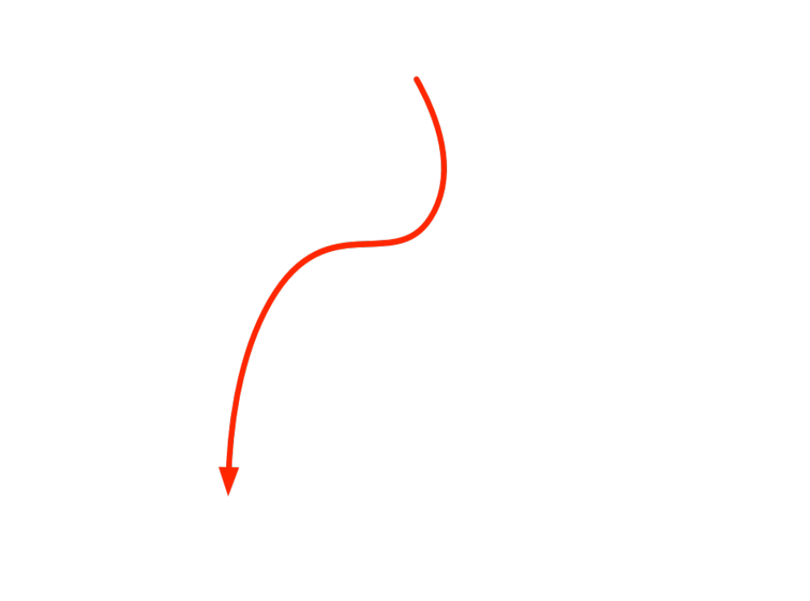
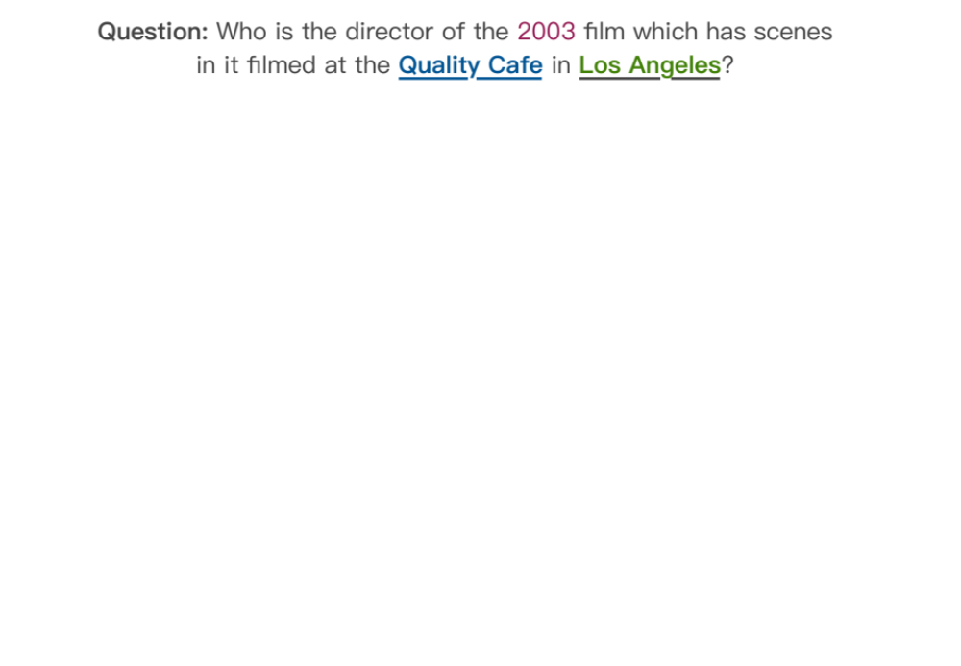
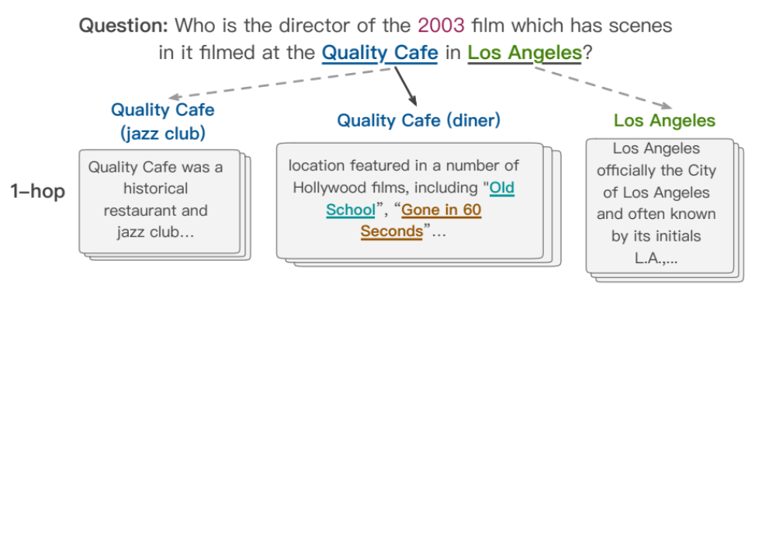
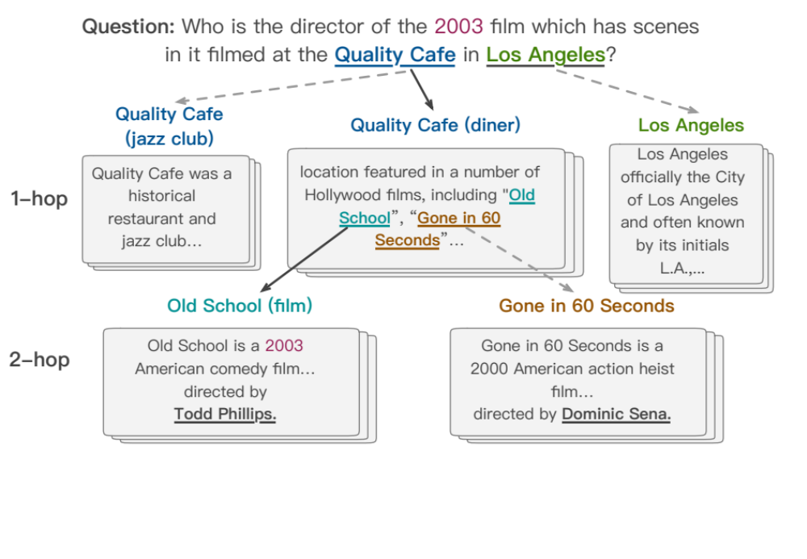
Ideal Results
Notes:
Imagine a scenario where you have a wikipedia to look up for any entity, and how can you answer such a question?(click)
Question…
We will first search quality café and los angeles which seems useful for answering the question. Okay there are two quality café but we find CLUES in the middle paragraph. There are two films featured here. And then we read the paragraph in wiki about the two films and find out there directors.
Now, we construct a graph step by step, which includes all possible answers and userful information. And our brain will analyze the whole information and chooses out the final answer.
We name this graph “cognitive graph”.
//
We get the final answer, and review the whole process, two non-trivial things were done by our brain. First, we identified useful entities from text such as “Old School” “Gone in 60 Seconds” “Todd Phillips”…This process is intuitively and simple. Then, we should reason out the final answer Todd Philips from other distractors for example Dominic Sena. This problem is much harder.

Slide 29
Connecting to Cognitive Science
System 1
Intuitive
System 2
Analytic
Dual Process Theory
Jonathan St BT Evans. 1984. Heuristic and analytic processes in reasoning. British Journal of Psychology, 75(4):451–468.

Slide 30
Reasoning w/ Cognitive Graph
System 1:
  Knowledge expansion by association in text when reading
System 2:
  Decision making w/ all the information
System 1
Intuitive
System 2
Analytic
Notes:
Dual process theory in cognition science says:

Slide 31

CogQA: Cognitive Graph for QA
An iterative framework corresponding to dual process theory
System 1
  extract entities to build the cognitive graph
  generate semantic vectors for each node
System 2
  Do reasoning based on semantic vectors and graph
  Feed clues to System 1 to extract next-hop entities
System 1
extract
Question
Cognitive Graph
input
Quality café
Los Angeles
…location featured in a number of Hollywood films, including Old School, Gone in 60 Seconds…
clues
Old school
Gone in 60 seconds
System 2
input
Todd Phillips
Dominic Sena
predict

Slide 32
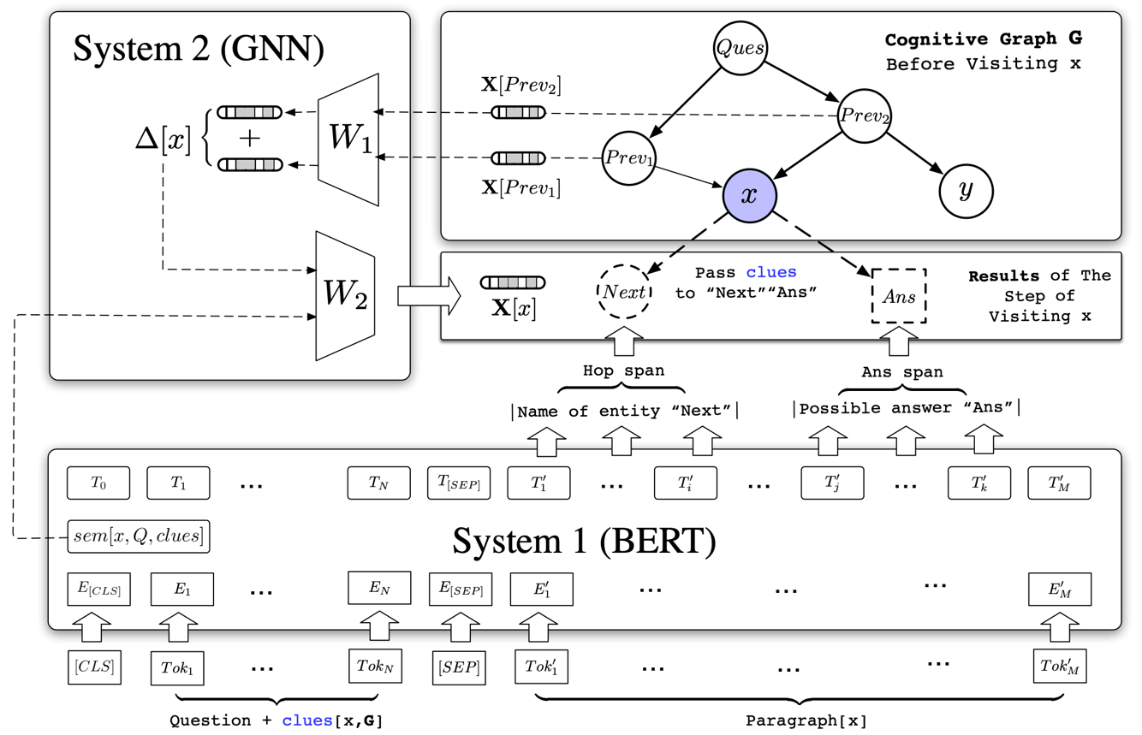
Cognitive Graph: DL + Dual Process Theory
explicit decision
implicit knowledge expansion
M. Ding, C. Zhou, Q. Chen, H. Yang, and J. Tang. Cognitive Graph for Multi-Hop Reading Comprehension at Scale. ACL’19.

Slide 33
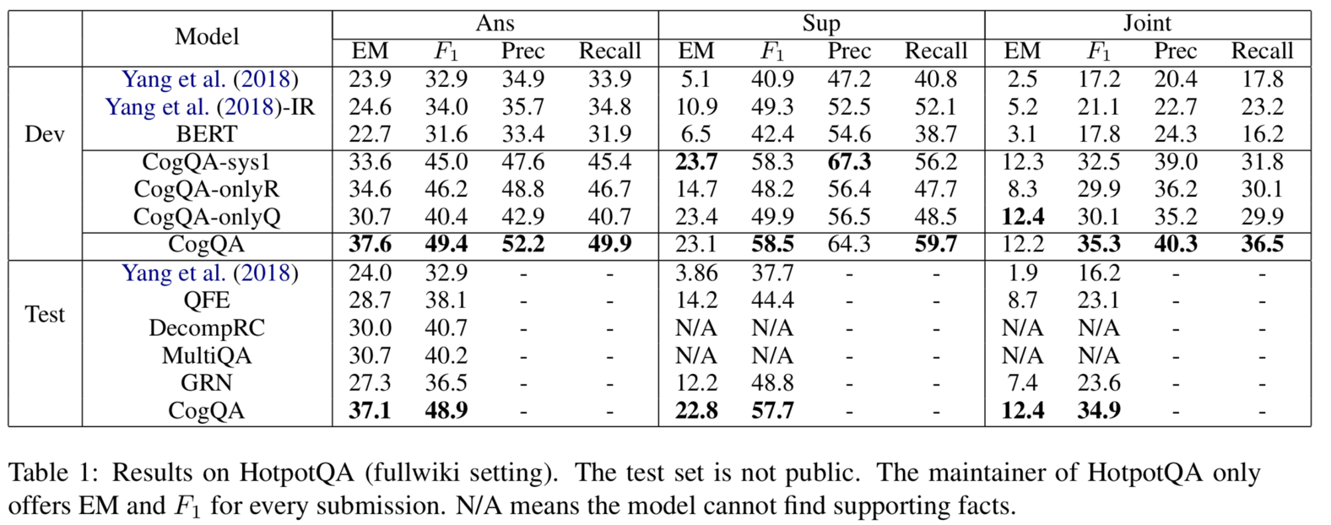
Performance
HotpotQA is a dataset with leaderboard similar to SQuAD
CogQA ranked 1st from 21, Feb to 15, May (nearly 3 month)
** Code available at https://github.com/THUDM/CogQA
Notes:
Two things to note:
Yang-IR: improved retrieval. We improve the retrieval process of Yang et al. for better comparison.
CogQA-onlyQ is designed that it only starts with the entities that appear in the question.
Free of elaborate retrieval methods, this setting can be regarded as a natural thinking pattern of human being, in which only explicit and reliable relations are needed in reasoning. CogQA-onlyQ still outperforms all the baselines

Slide 34
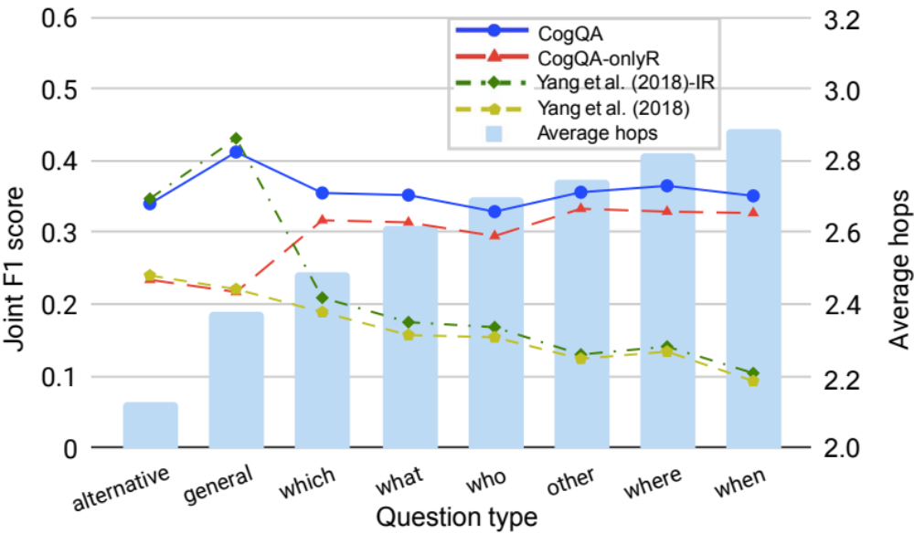
Reasoning Power
CogQA Performs much better on question with more hops！
Notes:
CogQA Performs much better on question with more hops

Slide 35
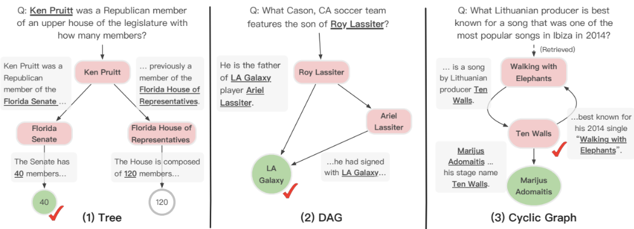
Case Study
Tree-shape Cognitive Graph
Users can verify the answer by comparing it with another possible reasoning chain.
“Upper House” in the question is similar to “Senate” not “House of Representative”
Notes:
We show how the cognitive graph clearly explains complex reasoning processes in our experiments.
The cognitive graph highlights the heart of the question in case (1) – i.e., to choose between the number of members in two houses. CogQA makes the right choice based on semantic similarity between “Senate” and “upper house”.
Case (2) illustrates that the robustness of answering can be boosted by exploring parallel reasoning paths.
In Case (3) our model finally gets the answer “Marijus Adomaitis” while the annotated ground truth is “Ten Walls”. However, when backtracking the reasoning process in cognitive graph, we find that the model has already reached “Ten Walls” and answers with his real name, which is acceptable and even more accurate. This is why we need explainability.

Slide 36
Case Study
DAG-shape Cognitive Graph
Multiple supporting facts provides richer information, increasing the credibility of the answer.

Slide 37
Case Study
CogQA gives the answer “Marijus Adomaitis” while the ground truth is “Ten Walls”.
By examining, Ten Walls is just the stage name of Marijus Adomaitis!
Without cognitive graphs, black-box models cannot achieve it.

Slide 38
Outline
Representation Learning for Complex Networks
Reasoning for Complex Scenarios
Generation for Explaining Prediction
Conclusion and Q&A

Slide 39




Example: Product Description Generation
User
Product
Product Description
Notes:
In online stores, how do people do this? Typically, people will communicate less often.
They read textual descriptions by themselves, and maybe also have a look at the images.
And online salesmen mainly provide assistance, instead of introducing product information and promoting sales.
不同的在线上购物中，用户对某个商品的了解是通过点击商品之后，阅读商品的描述文本以及看商品图实现的。这些商品描述主要是卖家预先写好的，相比线下的销售员，有很大的局限

Slide 40

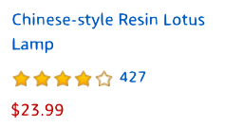
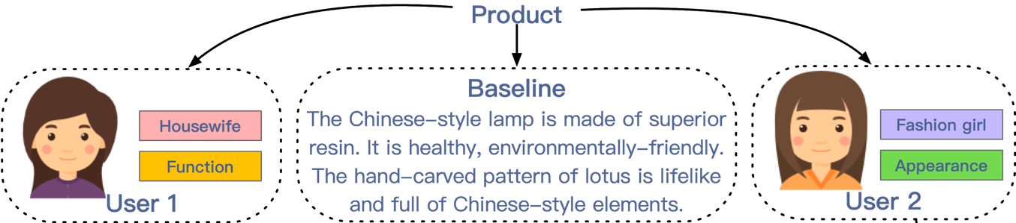
Recommendation– Different Users
Notes:
Suppose we have two users
举个例子，假设我们有两个不同的用户点击了同一个商品。
第一位用户是个家庭主妇，且更注重实用性；第二位用户更加年轻，并且更加注重外观。
我们发现不同的人对这些特点有不同的偏好，但我们总是对用户呈现固定的描述。

Slide 41
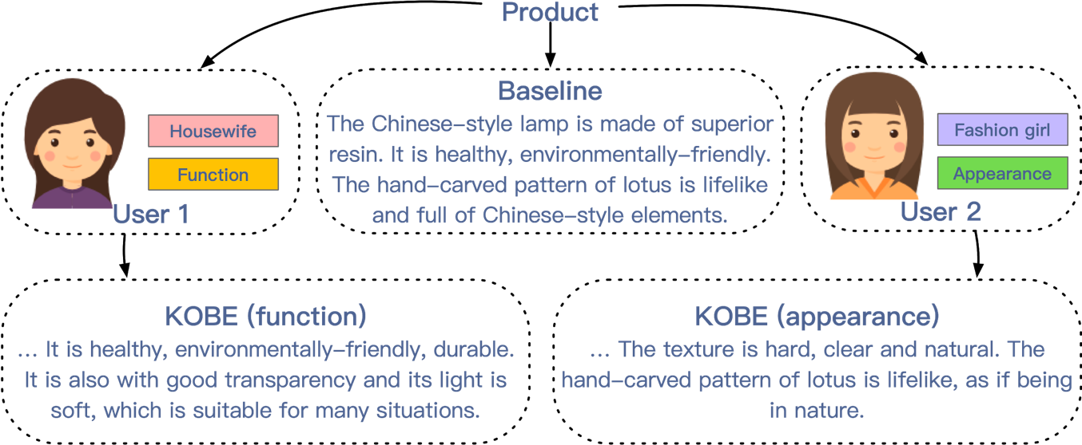
Recommendation– Different Users
Personalized Product Descriptions!
Notes:
于是我们认为应该给用户提供个性化的商品描述。

Slide 42
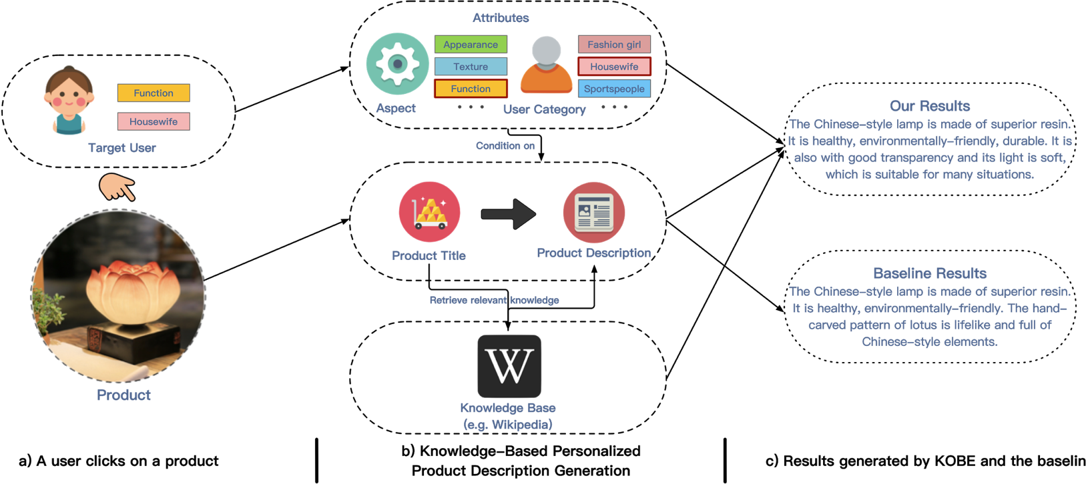
KOBE: KnOwledge Based pErsonalized product description generation model
Q. Chen, J. Lin, Y. Zhang, H. Yang, J. Zhou and J. Tang. Towards Knowledge-Based Personalized Product Description Generation in E-commerce. KDD’19.
Notes:
Overall, our model is based on a seq2seq framework. It auto-regressively predicts the next token, based on these inputs.
To achieve personalization, we take the desired control information as input and build a conditional seq2seq framework.
To make the descriptions informative and diverse, we incorporate knowledge from external knowledge bases.
KOBE generate a product description, given 1) the product title, 2) the desired product aspect and user category and 3) the relevant knowledge retrieved from an existing knowledge base.

Slide 43
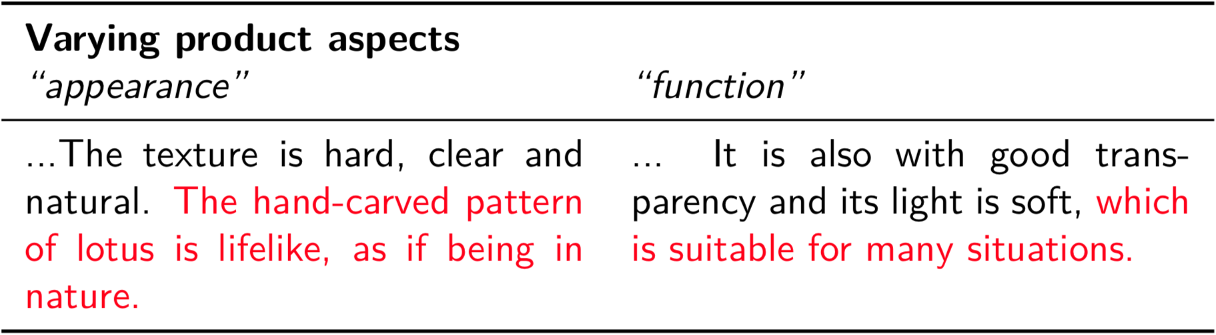
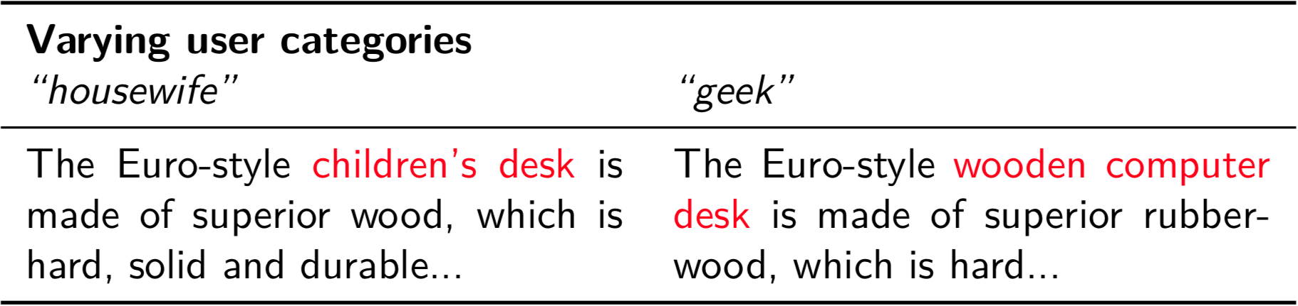
Case Study
Notes:
Now let’s have a look at some generated results.
This product is a Chinese-style lamp. For this product, we vary the control information.
On the left, we let the model to focus on the appearance of the product.
On the right, the function.
This is another example. It’s similar to the previous one but now we vary the user category attribute. This product is a Euro-style wooden desk.
On the left, we presume the user to be a housewife, while on the right, a geek.

Slide 44
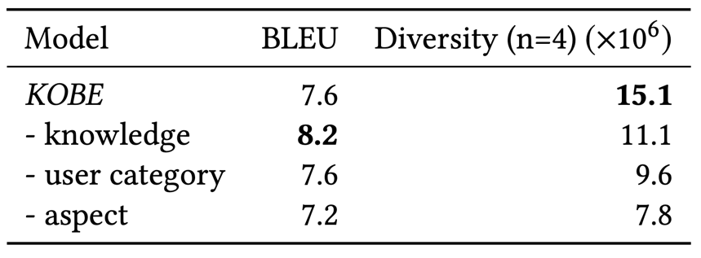
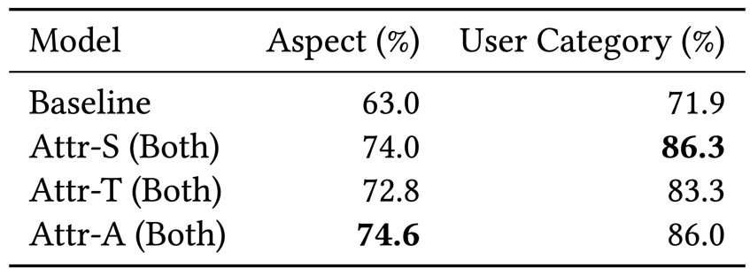
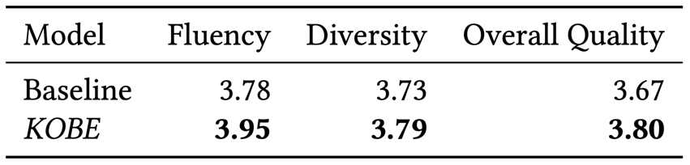
Experimental Results
Generation quality
  BLEU
Generation diversity
  Lexical diversity
Personalization
  Attribute capturing
Human evaluation
** All Data and Code available at https://github.com/THUDM/KOBE/
Notes:
First, does KOBE improve generation quality?
BLEU measures the overlap between the generated and the ground truth and is widely adopted for Seq2seq tasks such as machine translation.
We can see kobe improves the generation quality.
Second, does KOBE improve generation diversity?
The diversity score computed as the number of distinct ngrams generated on the test set.
The results show that both personalization and knowledge improve the diversity, which means more contents are generated.
Third, does KOBE achieve better personalization?
In other words, how well do we control the style of the product descriptions?
If the style information can be recovered from the generated text, we consider it successful.
So we train a classifier to predict attributes from ground truth descriptions and use it to predict the attributes of generated descriptions. If the more predictions match the input attributes, the score is higher.
The human evaluation also shows KOBE is better than the baseline.

Slide 45
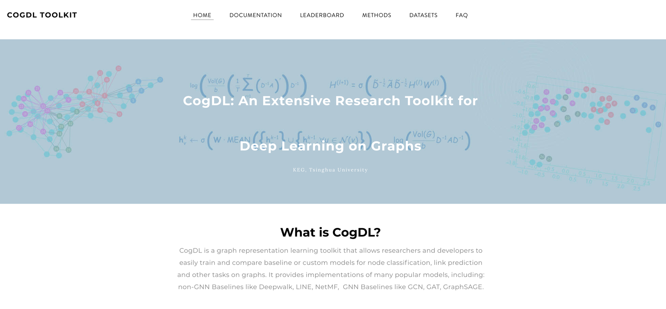
CogDL
—A Toolkit for ​Deep Learning on Graphs
** Code available at https://keg.cs.tsinghua.edu.cn/cogdl/

Slide 46
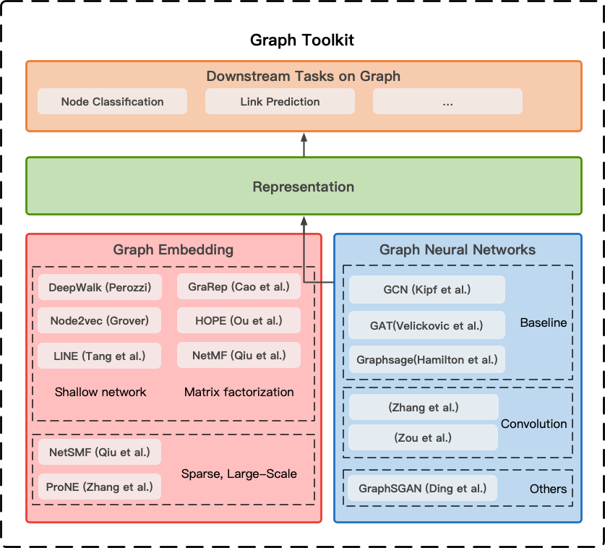
CogDL
—A Toolkit for ​Deep Learning on Graphs
Notes:
CogDL is a graph representation learning toolkit that allows researchers and developers to train baseline or custom models for node classification, link prediction and other tasks on graphs. It provides implementations of several models, including: non-GNN Baselines like Deepwalk, LINE, NetMF, GNN Baselines like GCN, GAT, Graphsage.

Slide 47
CogDL features
  CogDL supports these features:
  Sparsification: fast network embedding on large-scale networks with tens of millions of nodes
  Arbitrary: dealing with different graph structures: attributed, multiplex and heterogeneous networks
  Distributed: multi-GPU training on one machine or across multiple machines
  Extensible: easily register new datasets, models, criterions and tasks
  Homepage: https://keg.cs.tsinghua.edu.cn/cogdl/
Notes:
CogDL support these features: Sparsification, Arbitrary, Distributed, Extensible.

Slide 48
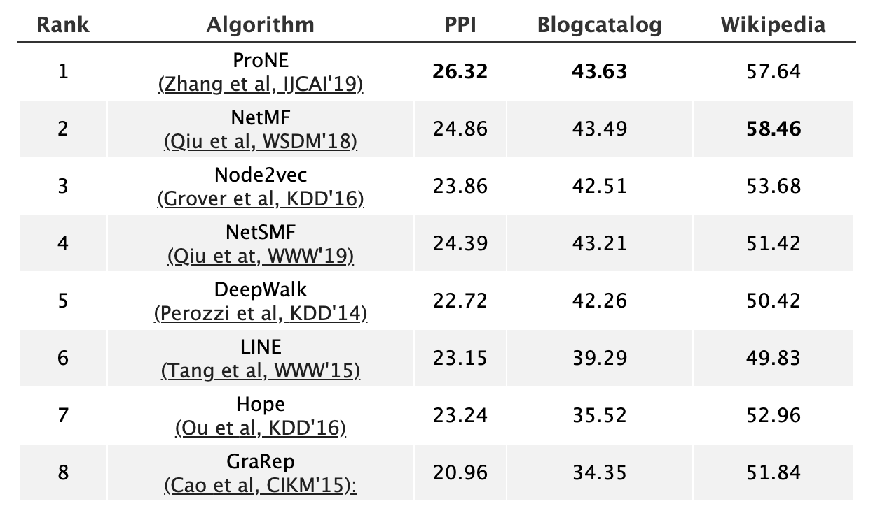
CogDL Leaderboards
Multi-label Node Classification
The following leaderboard is built from unsupervised learning with multi-label node classification setting.
http://keg.cs.tsinghua.edu.cn/cogdl/node-classification.html
Notes:
CogDL provides several downstream tasks including node classification (with or without node attributes), link prediction (with or without attributes, heterogeneous or not). These leaderboards maintain state-of-the-art results and benchmarks on these tasks.
The following leaderboard is built from unsupervised learning with multi-label node classification setting.
We run all algorithms on several real-world datasets and report the sorted experimental results.
ProNE performs best in all algorithms.

Slide 49
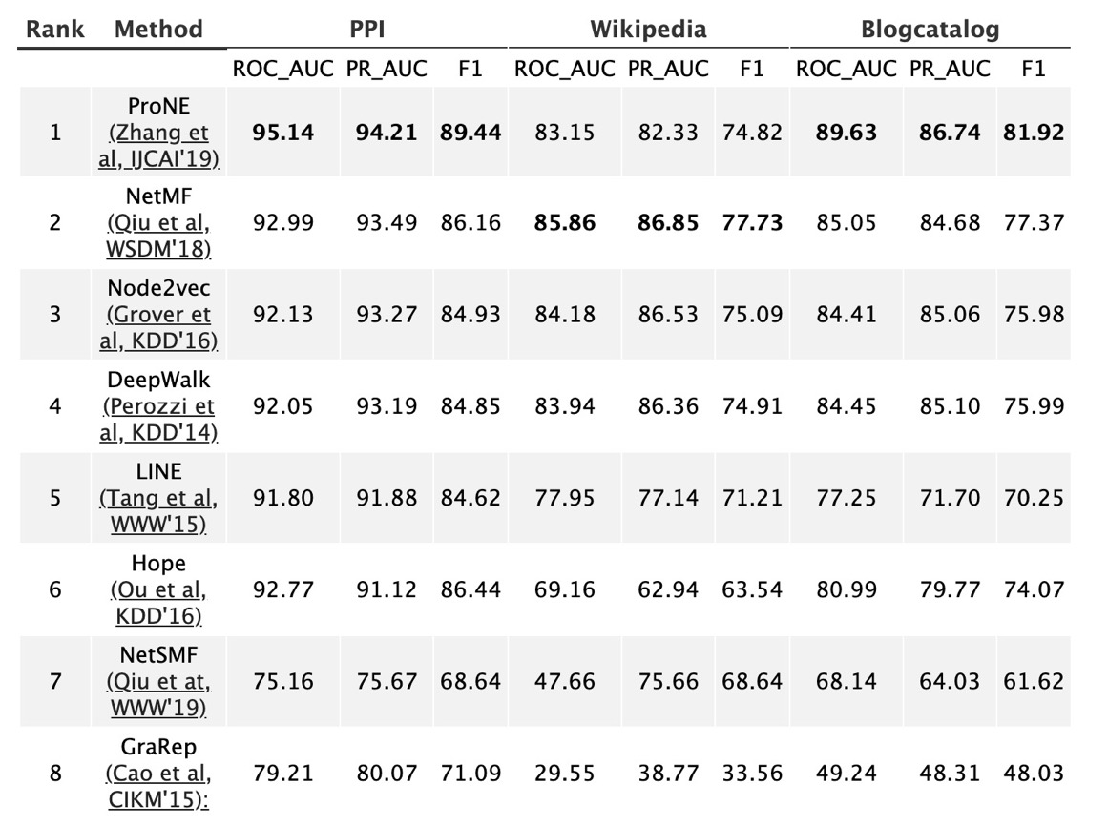
Leaderboards: Link Prediction
http://keg.cs.tsinghua.edu.cn/cogdl/link-prediction.html
Notes:
For link prediction, we adopt Area Under the Receiver Operating Characteristic Curve (ROC AUC), standard evaluation metric AUC and F1- score, which represents the probability that vertices in a random unobserved link are more similar than those in a random nonexistent link. We evaluate these measures while removing 15 percents of edges on these dataset. We repeat our experiments for 10 times and report the three matrices in order.

Slide 50
Join us
Feel free to join us with the three following ways:
  add your data into the leaderboard
  add your algorithm into the leaderboard
  add your algorithm into the toolkit
  Note that, in order to collaborate with us, you may refer to the documentation in our homepage.
Notes:
You are welcome to join us.

Slide 51
Cognitive Graph: DL + Dual Process Theory
explicit decision
implicit knowledge expansion
M. Ding, C. Zhou, Q. Chen, H. Yang, and J. Tang. Cognitive Graph for Multi-Hop Reading Comprehension at Scale. ACL’19.

Slide 52
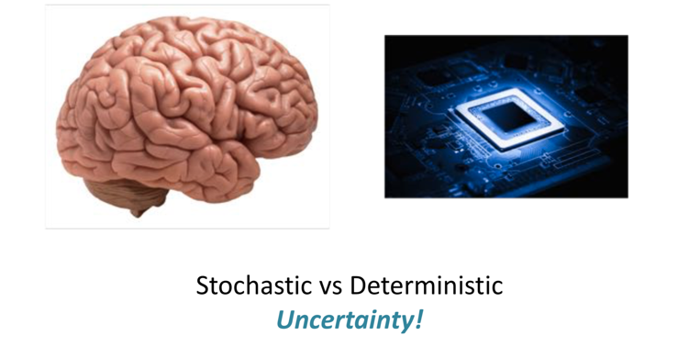
Future
From perception to cognition
存储与计算
感知
文本、语音
图像、视频
知识组织
知识推理
知识生成
计算
感知
认知

Slide 53
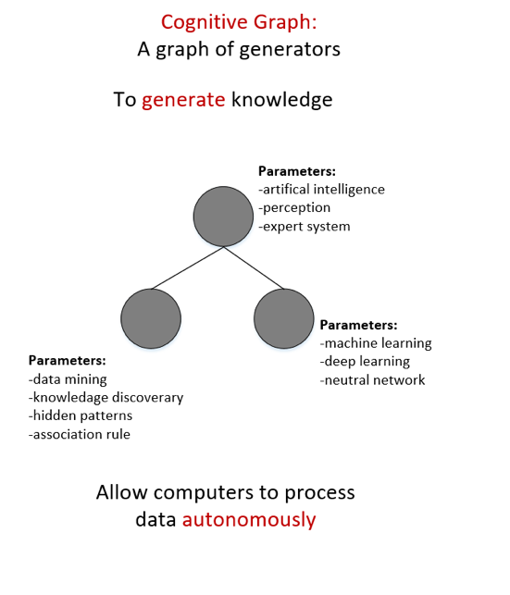
ReReThinking… (Starting from CNCC’19)
数据
知识图谱
认知图谱
Cognitive Reasoning:
A graph of computing nodes (agents)
To generate intelligence
?
数据处理的自动化
数据处理的自治性
计算的自发性

Slide 54
Related Publications
Jie Zhang, Yuxiao Dong, Yan Wang, Jie Tang, and Ming Ding. ProNE: Fast and Scalable Network Representation Learning. IJCAI’19.
Yukuo Cen, Xu Zou, Jianwei Zhang, Hongxia Yang, Jingren Zhou and Jie Tang. Representation Learning for Attributed Multiplex Heterogeneous Network. KDD’19.
Fanjin Zhang, Xiao Liu, Jie Tang, Yuxiao Dong, Peiran Yao, Jie Zhang, Xiaotao Gu, Yan Wang, Bin Shao, Rui Li, and Kuansan Wang. OAG: Toward Linking Large-scale Heterogeneous Entity Graphs. KDD’19.
Yifeng Zhao, Xiangwei Wang, Hongxia Yang, Le Song, and Jie Tang. Large Scale Evolving Graphs with Burst Detection. IJCAI’19.
Yu Han, Jie Tang, and Qian Chen. Network Embedding under Partial Monitoring for Evolving Networks. IJCAI’19.
Ming Ding, Chang Zhou, Qibin Chen, Hongxia Yang, and Jie Tang. Cognitive Graph for Multi-Hop Reading Comprehension at Scale. ACL’19.
Jiezhong Qiu, Yuxiao Dong, Hao Ma, Jian Li, Chi Wang, Kuansan Wang, and Jie Tang. NetSMF: Large-Scale Network Embedding as Sparse Matrix Factorization. WWW'19.
Jiezhong Qiu, Jian Tang, Hao Ma, Yuxiao Dong, Kuansan Wang, and Jie Tang. DeepInf: Modeling Influence Locality in Large Social Networks. KDD’18.
Jiezhong Qiu, Yuxiao Dong, Hao Ma, Jian Li, Kuansan Wang, and Jie Tang. Network Embedding as Matrix Factorization: Unifying DeepWalk, LINE, PTE, and node2vec. WSDM’18.
Jie Tang, Jing Zhang, Limin Yao, Juanzi Li, Li Zhang, and Zhong Su. ArnetMiner: Extraction and Mining of Academic Social Networks. KDD’08.
  For more, please check here http://keg.cs.tsinghua.edu.cn/jietang

Slide 55
Thank you！
Collaborators:
Jie Zhang, Jiezhong Qiu, Ming Ding, Qibin Chen, Yifeng Zhao, Yukuo Cen, Yu Han, Fanjin Zhang, Xu Zou, Yan Wang, et al. (THU)
Hongxiao Yang, Chang Zhou, Le Song, Jingren Zhou, et al. (Alibaba)
Yuxiao Dong, Chi Wang, Hao Ma, Kuansan Wang (Microsoft)
  Jie Tang, KEG, Tsinghua U http://keg.cs.tsinghua.edu.cn/jietang
  Download all data & Codes https://keg.cs.tsinghua.edu.cn/cogdl/

